Slide 1


Choose Life Ministries
A faith based ministry
solely supported by churches & individuals.
Building a Biblical View of LIFE
www.chooselifeusa.org

Slide 2
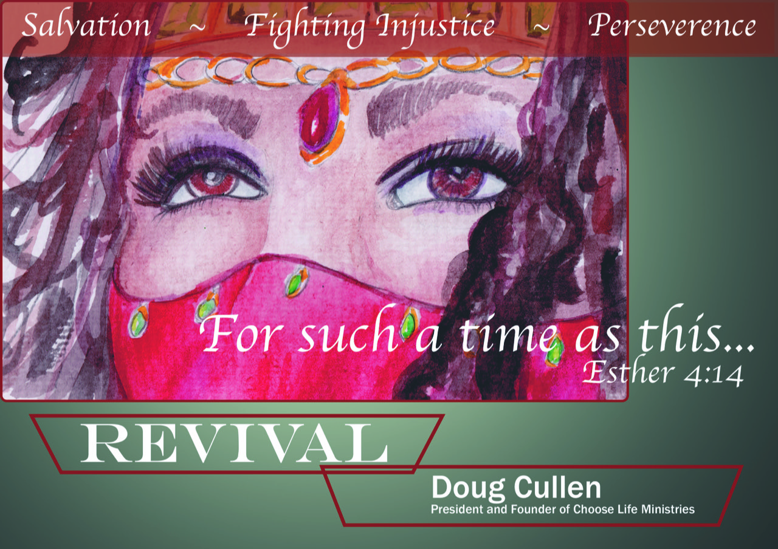

Slide 3
Choose Life Ministry Updates
*PLEASE PICK UP OUR
BUSINESS CARD at the table
& call or text us: 606-269-3099
For more information
*GO TO OUR WEBSITE:
www.CHOOSELIFEUSA.ORG

Slide 4

Deuteronomy 30:19
I call heaven and earth to record this day against you, that I have set before you life and death, blessing and cursing: therefore, choose life, that both thou and thy seed may live:

Slide 5
1 John 1:9
If we confess our sins, He is faithful and just to forgive us our sins, and to cleanse us from all unrighteousness.

Slide 6

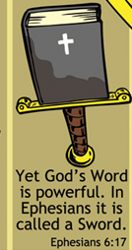

Slide 7
✞ Genesis 1:27
So God created man in His own image; in the image of God created He him; male and female created He them.

Slide 8
1 Peter 1:18-19
For as much as ye know that ye were not redeemed with corruptible things, as silver and gold, from your vain conversation received by tradition from your fathers;
But with the precious blood of Christ, as of a lamb without blemish and without spot:

Slide 9
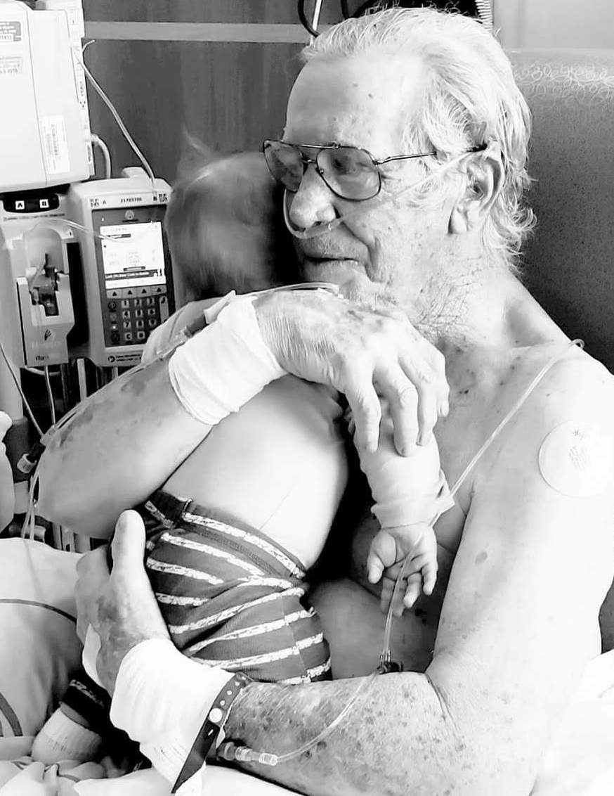
LEGAL ASSISTED SUICIDE
Euthanasia
9 States
The culture of death
Encourages people who
Cannot ‘contribute to
Society” to be Euthanized.
There are laws being passed today where a baby, just after birth, can be euthanized because of any disability.

Slide 10
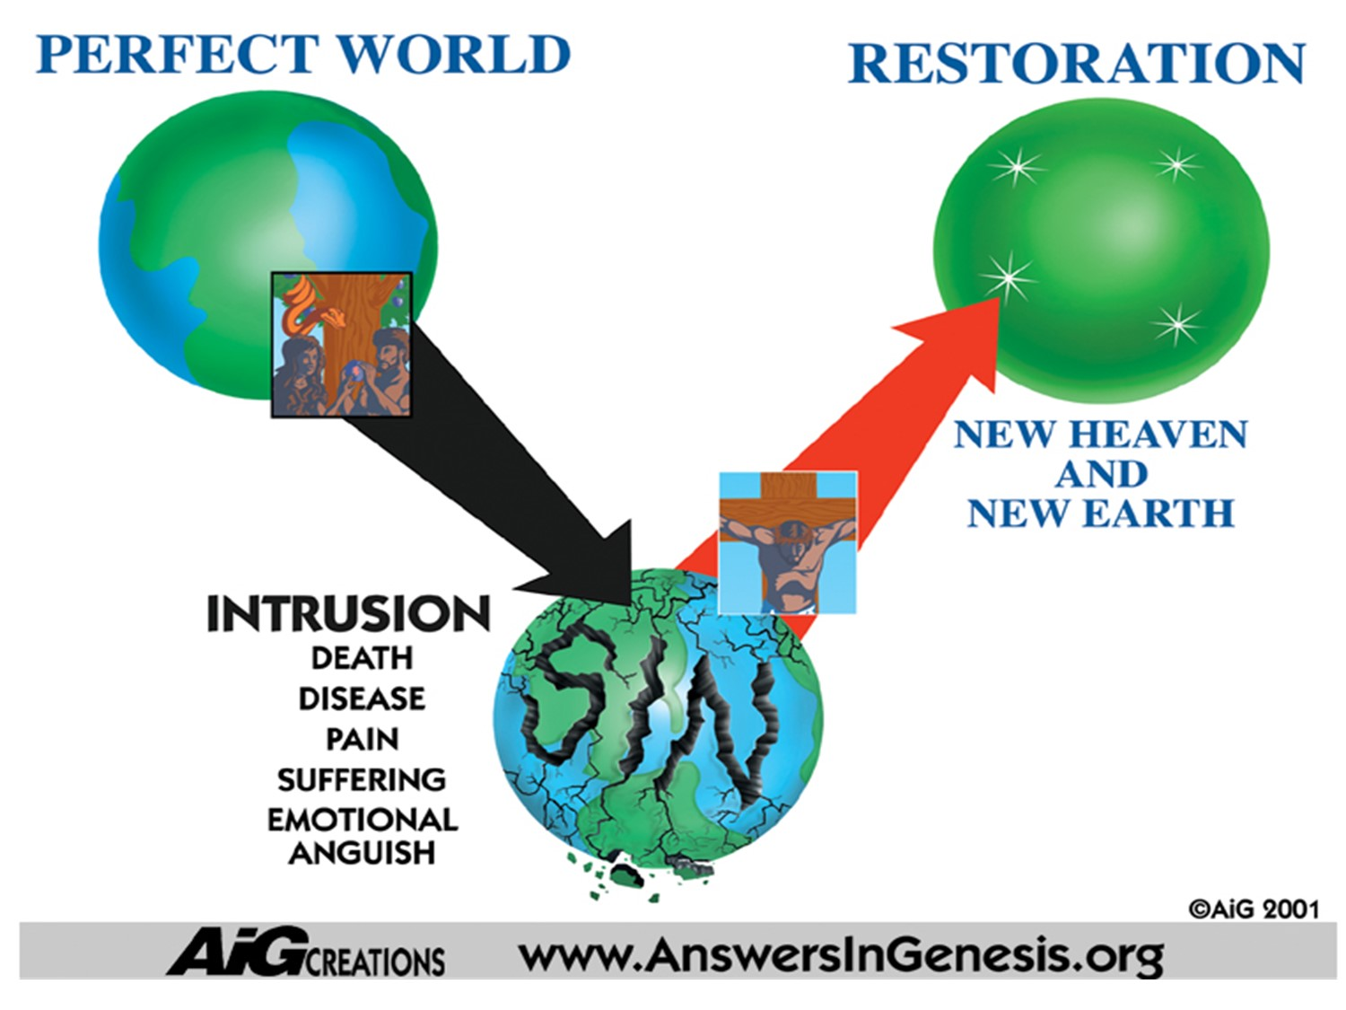
Psalm 51
For I acknowledge my
transgressions:
and my sin is ever
before me.
Against thee, thee only,
have I sinned,

Slide 11
Psalm 139:13-16
13. For thou hast possessed my reins: thou hast covered me in my mother’s womb.
14. I will praise thee; for I am fearfully and wonderfully made: Marvelous are thy works; and that my soul knoweth right well.

Slide 12
15. My substance was not hid from thee, when I was made in secret, and curiously wrought in the lowest parts of the earth.

Slide 13
16. Thine eyes did see my substance, yet being imperfect; and in your book all my members were written,
which in continuance were fashioned, when as yet there were none of them.

Slide 14
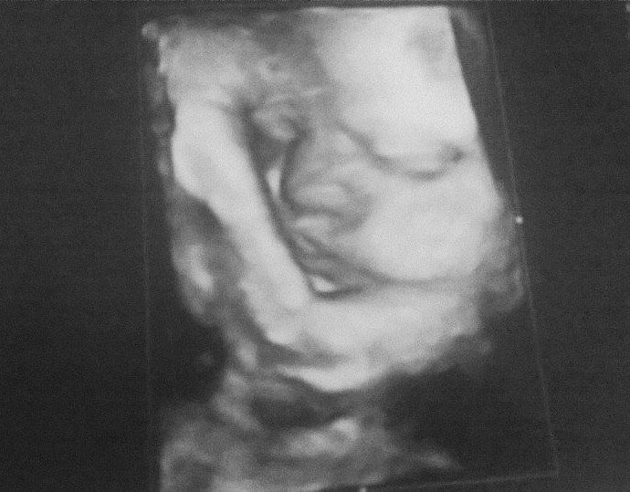
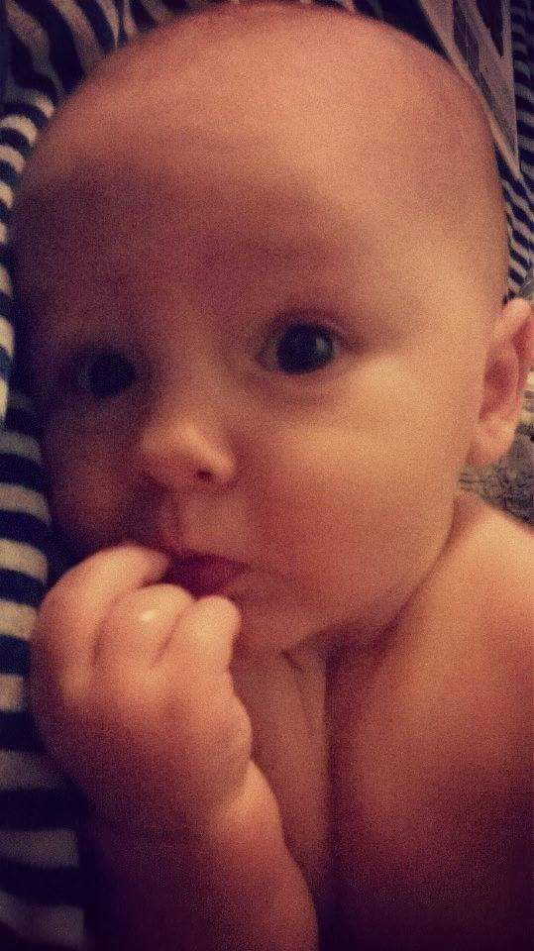
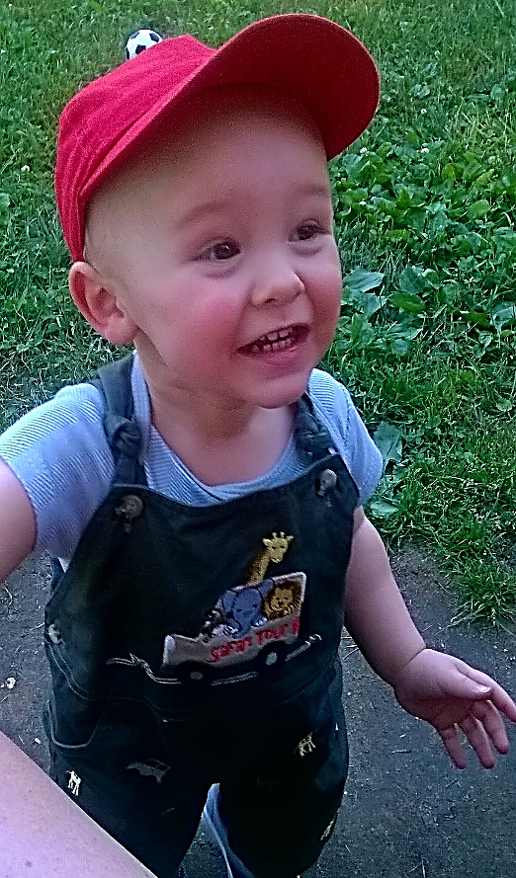
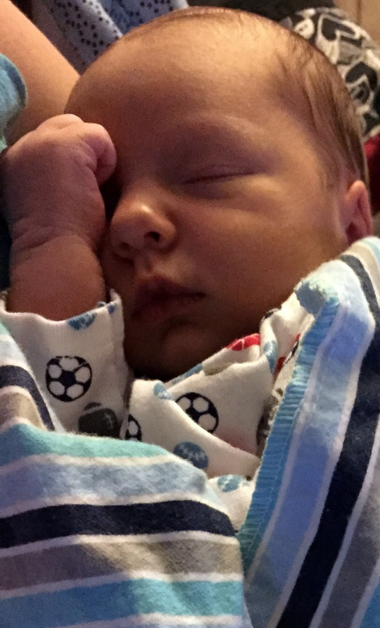

Ephesians 2:10
For we are God’s workmanship, created in Jesus for good works…

Slide 15
Isaiah 5:20
Woe unto them that call evil good, and good evil; that put darkness for light, and light for darkness; …
" The only thing required for evil to prevail is for good men to do nothing.”
Edmund Burke

Slide 16
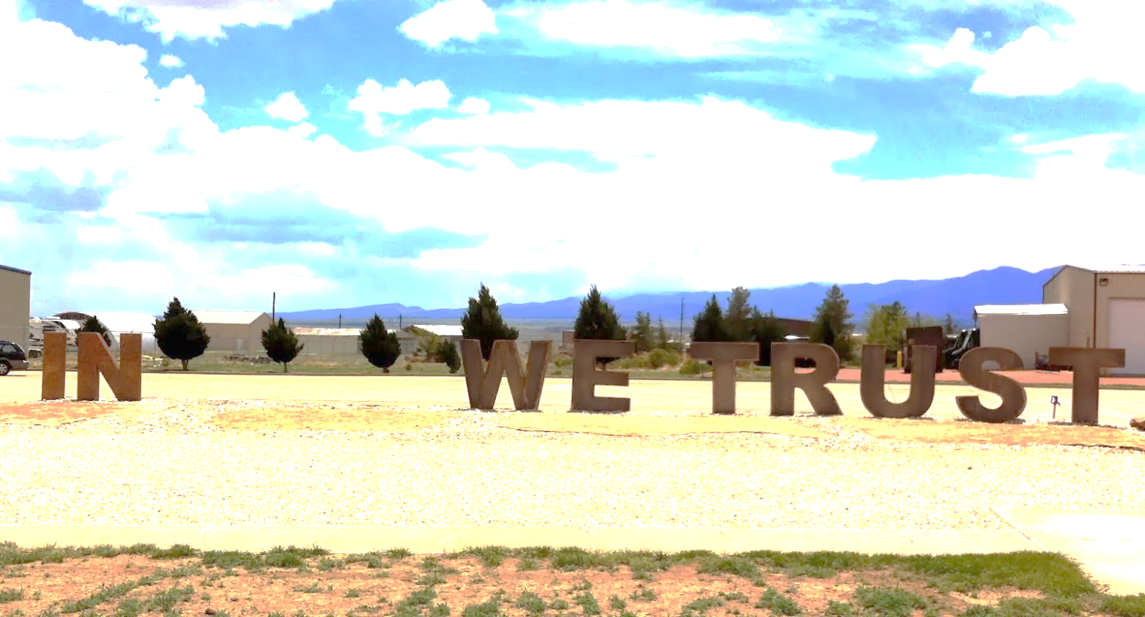

Slide 17
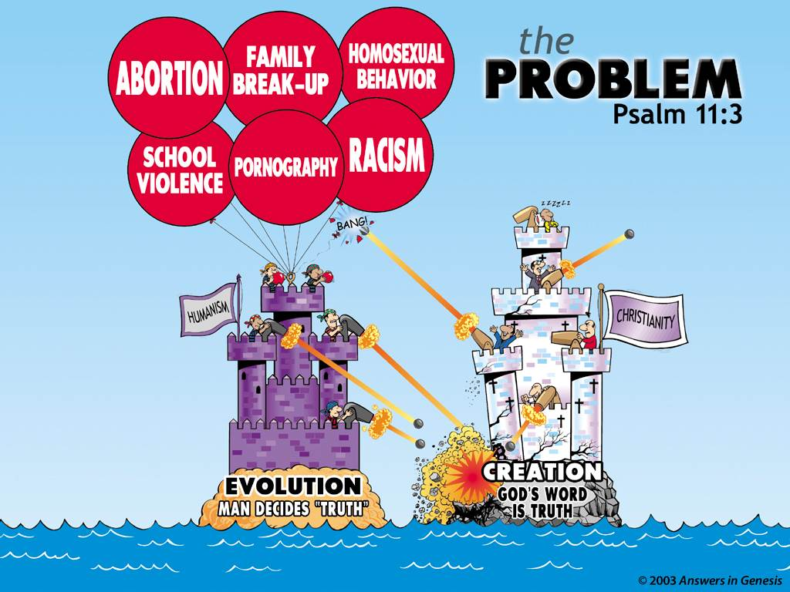

Slide 18
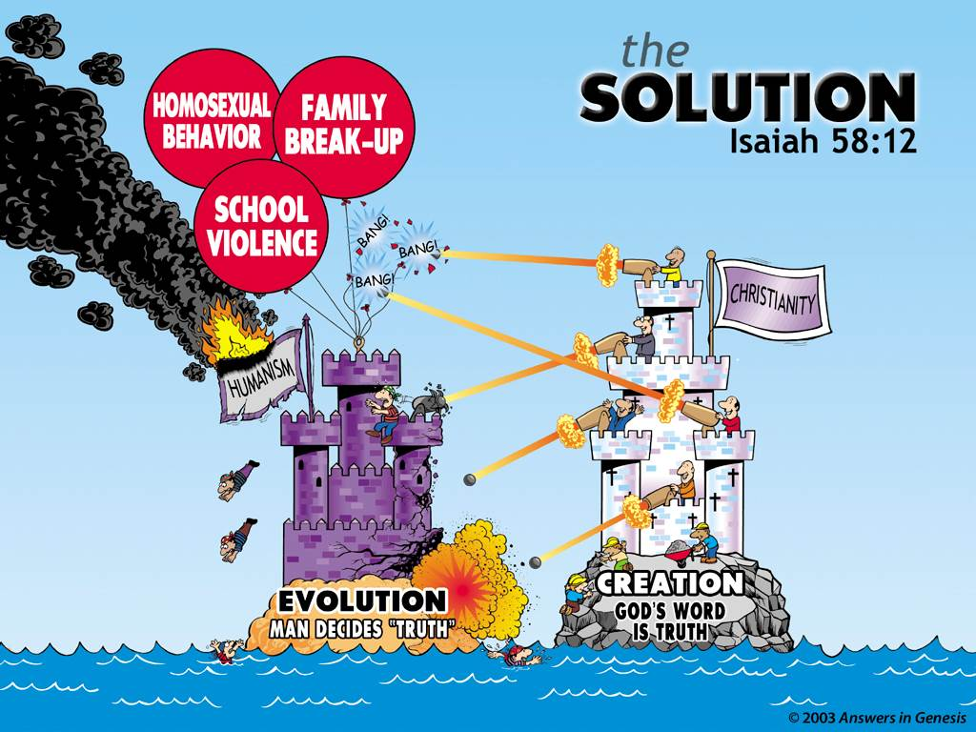

Slide 19
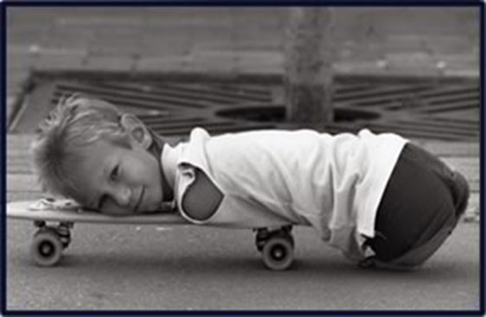
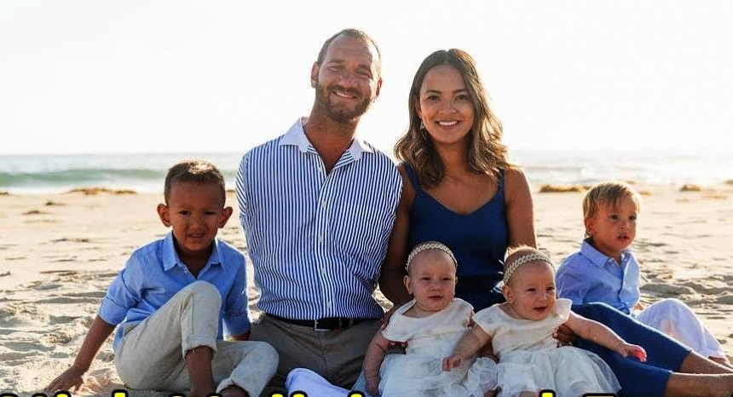
Secular Huminism
Abort the “IMPERFECT CHILD”
BIBLICAL WORLDVIEW
Exodus 4:11
Genesis 1:27
Psalm 127:3; 139
Isaiah 45:9-11
Isaiah 64:8
Romans 8:28: 9:20
1 Corinthians 1:27
www.lifewithoutlimbs.org

Slide 20
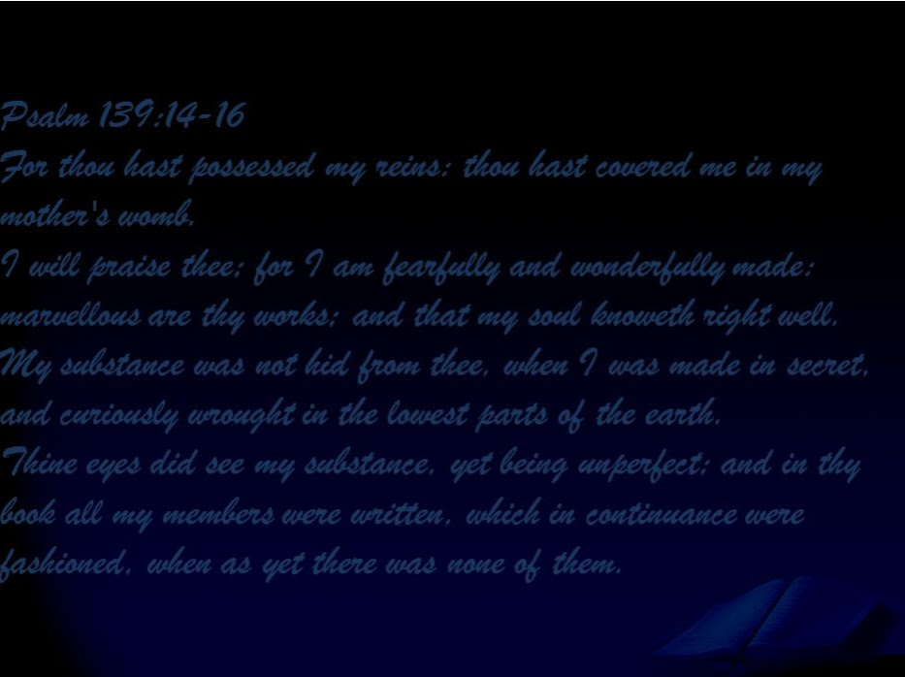

Nick Vujcic

Slide 21
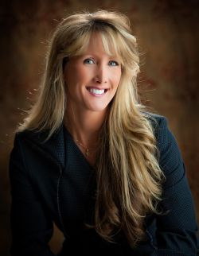
SECULAR HUMANISM
Abort in the case of rape
Biblical Worldview
Deuteronomy 24:16
Ezekiel 18:2-4, 20
Romans 8:28
Rebecca was conceived in rape, but Rebecca is not a product of rape, she is a CHILD OF GOD.
Please pick up her brochure
“Conceived in Rape”
rebeccakiessling.com

Slide 22
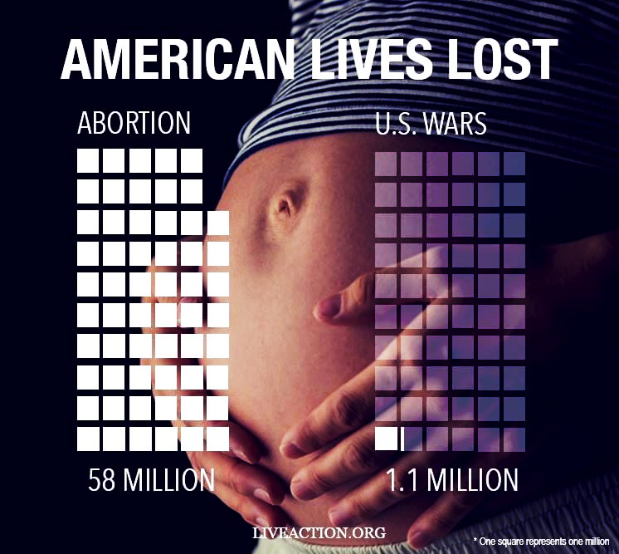
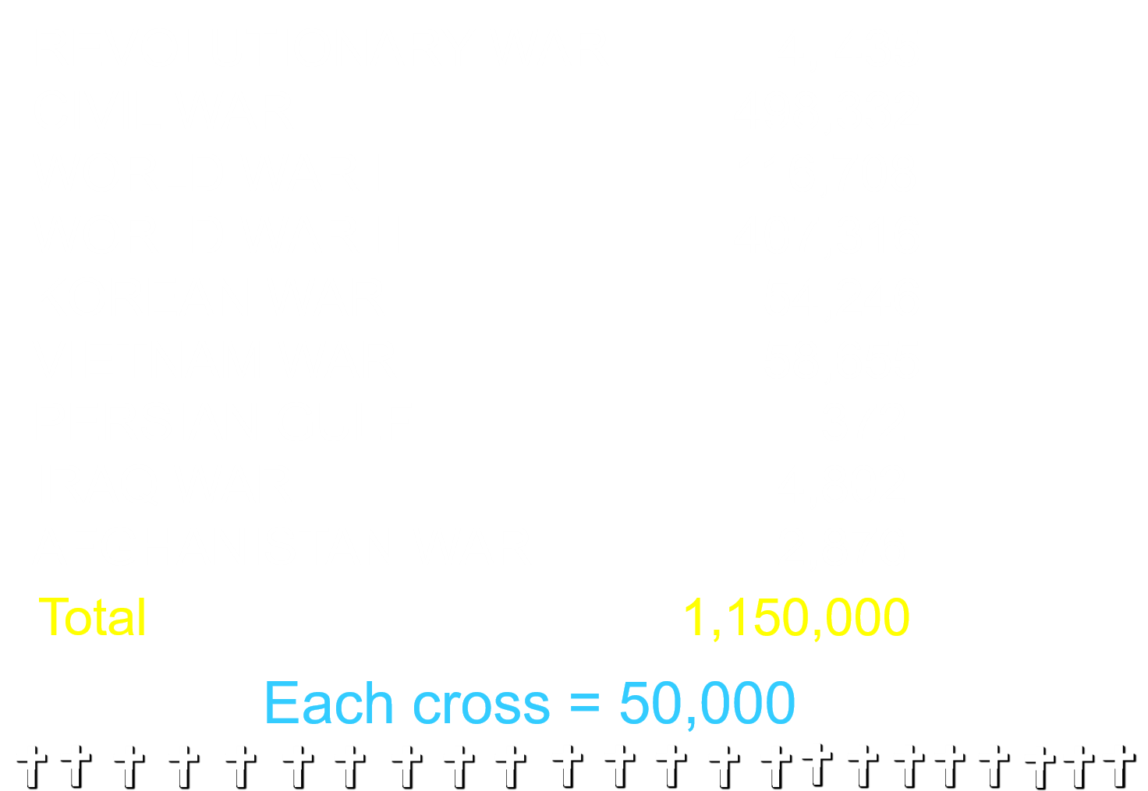
60 + million 1.1 million

Slide 23
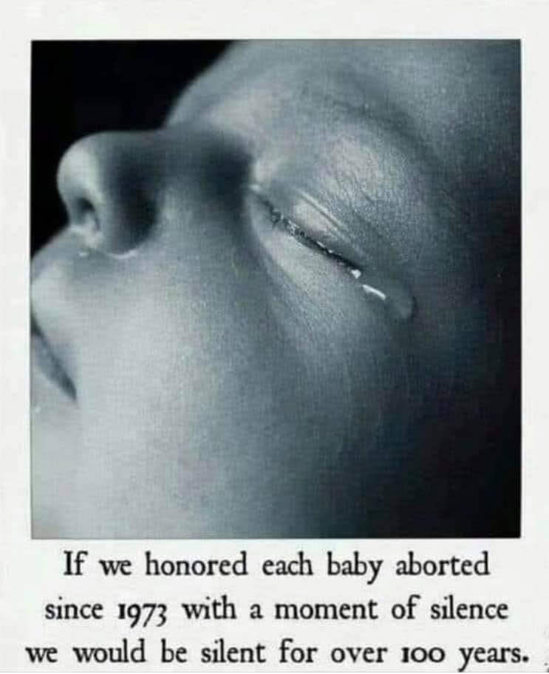
= 50,000 babies
Killed in the
United States.
95% for convenience.
= 500 babies
Killed in the
United States
for disability.

Slide 24


Slide 32
And He said, what
hast thou done?
the voice of thy brother’s blood crieth unto Me from the ground.
Genesis 4:10

Slide 33
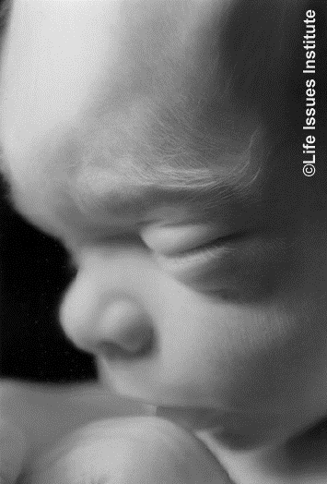
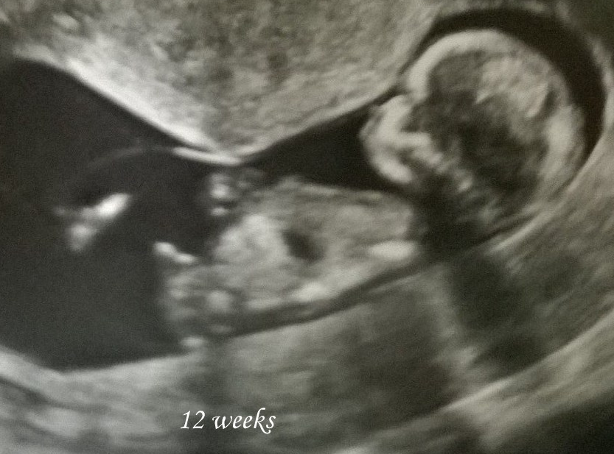
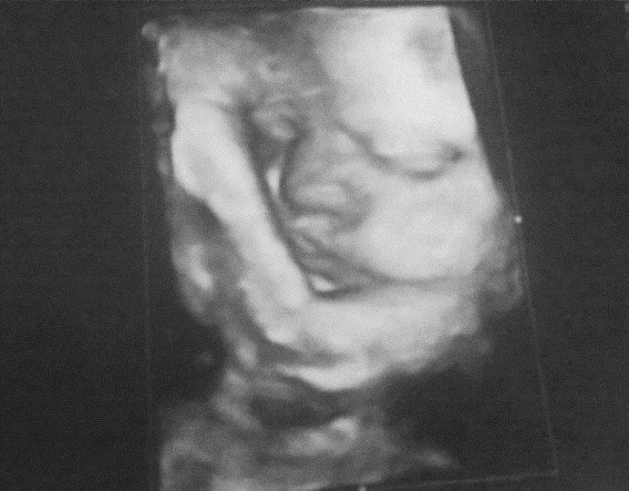

1 out of 4 pregnancies end in an abortion
www.lifeissues.org

Slide 34
Matthew 5:13-15
13. Ye are the salt of the earth: but if the salt has lost its savor, wherewith shall it be salted?
14. It is thenceforth good for nothing, but to be cast out, and trod under foot of men.

Slide 35
15. Ye are the light of the world.
A city that is set on a hill cannot be hid. Neither do men light a candle, and put it under a bushel, but on a candlestick ; and it giveth light to all that are in the house.

Slide 36
“What Can I Do ”
 SUPPORT YOUR LOCAL PREGNANCY CENTER.
 EDUCATE OTHERS
 VOTE PRO-LIFE - PERSONHOOD
 GO TO OUR WEBSITE
chooselifeusa.org/activity

Slide 37
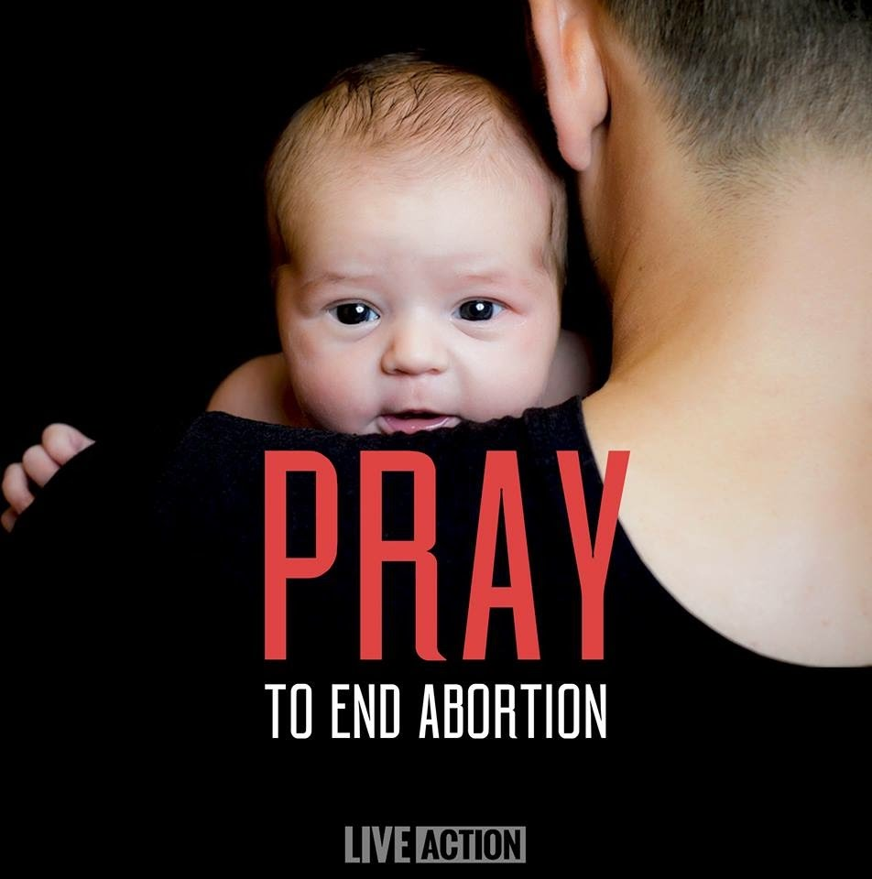
Pray 2 Tim. 2:1-2
I exhort therefore, that,
first of all, supplications, prayers,
intercessions, and giving of thanks,
be made for all men;
2 For kings, and for all
that are in authority…
CHURCH
2nd Chronicles 7:14
Ephesians 5:14 & Romans 13:11
UNITED STATES
Local and National Government
Our Supreme Court Justices
presidentialprayerteam.org

Slide 38

Pray for PASTORS
Hebrews 13:18
2 Thessalonians 3:1
Pray for PREGNANCY
CARE CENTERS
1 Corinthians 15:58
Pray for your Youth & Children by name.
1 Timothy 4:12
Pray for Choose LIFE Ministries
2 Corinthians 2:15-16

Slide 39
Genesis 1:27
Remember all human life is created in the image of God regardless of the color of the skin, language they speak or special needs they might have.

Slide 40
Psalm 139:13-16
Remember we serve a very patient loving Heavenly Father that desires a relationship with each and every one of us.

Slide 41
Genesis 1:27
Remember, we are to be
SALT and LIGHT.
We may be the only
SALT and LIGHT
some people will ever encounter.

Slide 42
God’s Word
Prayer
Activity

Slide 43
1 John 4:10
Herein is love, not that we loved God, but that he loved us, and sent his Son to be the propitiation for our sins.

Slide 44
Isaiah 44:24
Thus saith the LORD, thy redeemer, and he that formed thee from the womb, I am the LORD that maketh all things; that stretcheth forth the heavens alone; that spreadeth abroad the earth by myself;

Slide 45


“Baby’s Prayer” by Kathy Triccoli

Slide 46
